Slide 1
Design and Configure a Small Company Network Using VLANs Company Network Design

Slide 2
BY THE FOLLOWING: NUELLA EMMANUELA SUCCESS SILAS

Slide 3
Introduction
A company network was divided using VLANs to improve security and organization.
Each department has its own VLAN and IP network.

Slide 4
Project Scenario
Departments:
• Admin
• IT
• HR
• Sales
• Reception
Requirements:
• Separate VLANs
• Different IP networks

Slide 5
Objectives
1. Design network topology
2. Configure VLANs
3. Assign IPs
4. Configure switches
5. Test connectivity

Slide 6
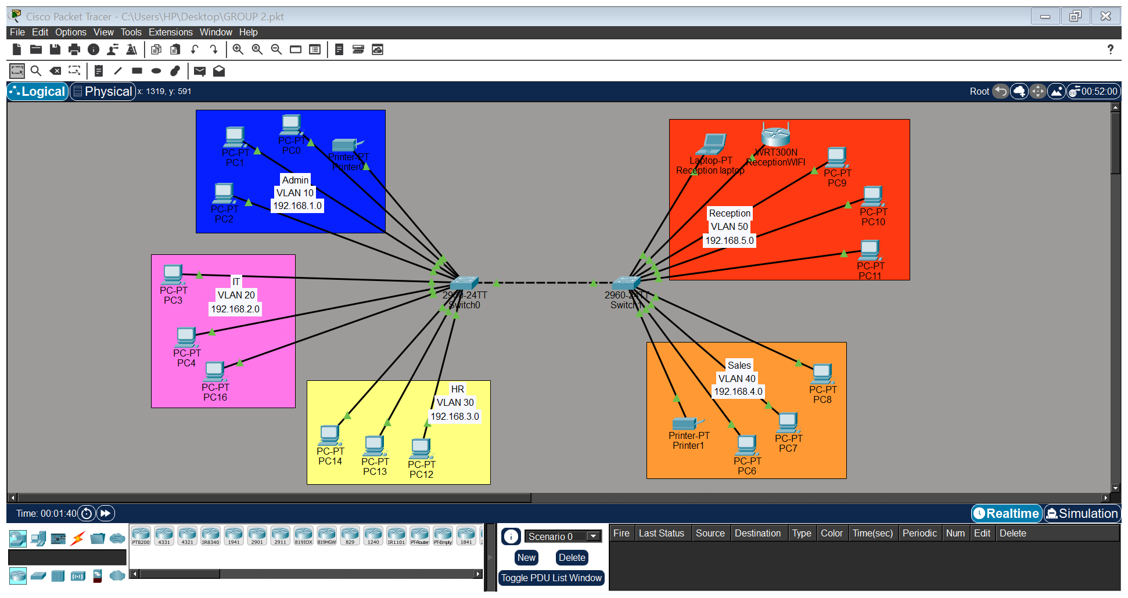
Network Topology

Slide 7
VLAN Table
Admin–10
IT–20
HR–30
Sales–40
Reception–50

Slide 8
IP Addressing
192.168.1.0/24
192.168.2.0/24
192.168.3.0/24
192.168.4.0/24
192.168.5.0/24

Slide 9
Switch Configuration
Enable
Configure Terminal
Vlan 10
Name ADMIN
Interface Fa0/24
Switchport Mode Access
Switchport access VLAN 10

Slide 10
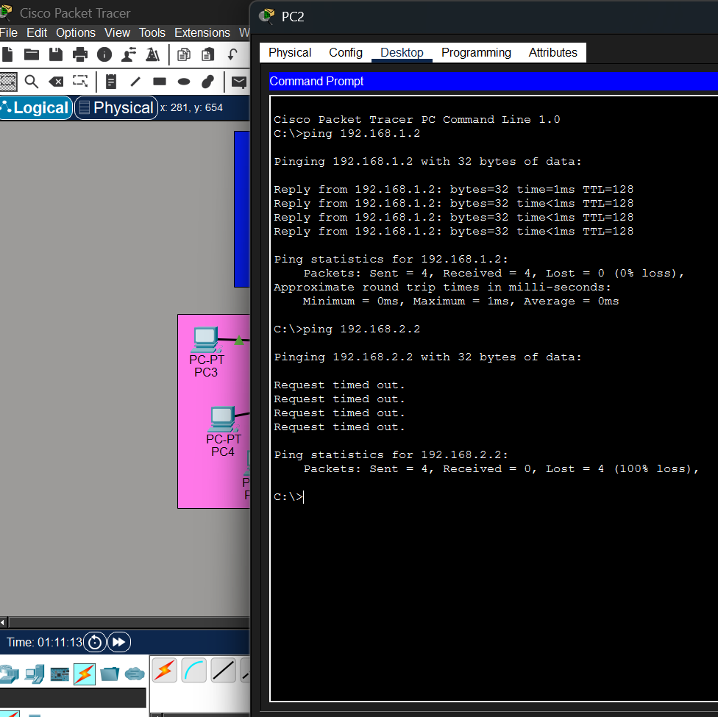
Testing & Results
Successful ping within same VLAN
Failed ping across different VLANs

Slide 11
Challenges & Lessons
Understanding VLAN concepts for the first time.
Assigning correct ports to VLANs.
Troubleshooting failed connectivity tests.
Learning Cisco commands.
The reception laptop not able to connect with the reception Wi-Fi

Slide 12
Conclusion
VLANs improve security, organization, and network management.

Slide 13
Future Improvements
Configuring the wireless router
Inter-VLAN routing

